Slide 1
Wireless fire systems
Fire safety
Presented By
P.ANITHA

Slide 2
INTRODUCTION
Automatic fire safety systems are intended to notify the building occupants to evacuate in the event of a fire or emergency, to prepare the associated systems to control the fire, smoke and to make some other necessary actions.

Slide 3
Automatic Initiating Devices
Heat ,smoke , flame and water flow detectors, etc.
These will all sense changes in the environment and react automatically in the event of an emergency.
New innovations in automatic initiating devices use cameras and computer algorithms to analyze visible effects of fire and movement in ways that other detection devices can’t.

Slide 4


Notification
Event notifications can be sent via email, mobile phone application , social media contacts such as Facebook, twitter, Instagram etc.., mobile, web database , control room monitor.
Social media contacts such as Facebook, twitter, Instagram
Detectors
Mobile
Cloud
Control Panel
Mobile Phone Application
GPRS/ Ethernet Gateway
Email Alert
Web Database
Control Room Monitor

Slide 5
Social Media Considerations
Twitter:
Twitter is by far the most used social media tool for mass notification because of its popular appeal.
Twitter offers an access to an API that can easily integrate into notification system
RED ALERT API:
RED ALERT is an emergency notification system to send mass notifications via phone, SMS, web interface, telephone operator and e-mail.
It can also be used to send event notifications and event reminders on a daily, weekly, or monthly basis, and for one-time special events. The SOAP API allows developers to programmatically access RED ALERT functionality and integrate it into their systems.

Slide 6
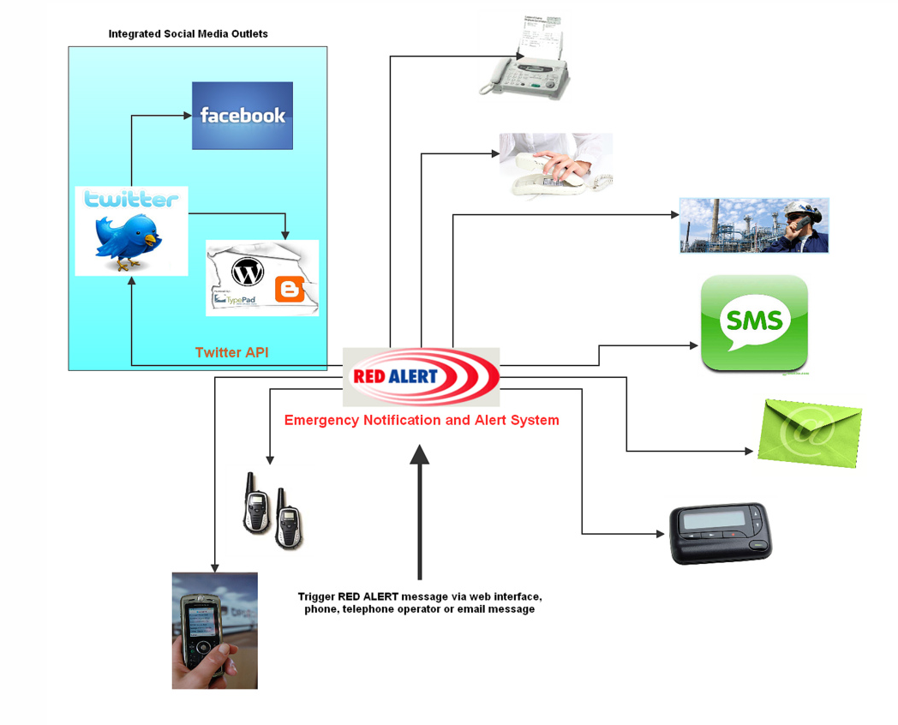
RED ALERT API
Vendor - AMTELCO
As an integrated part of RED ALERT, administrators can use RED ALERT as a single point to post messages or share information with Social Media outlets such as Twitter and Facebook as well as send messages to traditional communication devices.
Integrating Social Media with traditional platforms will help our hospital customers communicate with many more people than in the past.
Now, events such as changing weather conditions, flu season information, disasters, health news, wellness class information and emergency room wait times can be handled by RED ALERT and the Social Media integration to get information to anyone that wants it, and from whatever source they choose to receive it from.

Slide 7
Social Media Considerations (Contd..)
Twitter
Twitter has the facility to send a notification in an automated manner by automating the tweets, automated direct messages.
Twitter Automation tools are used to post an automated tweet whenever the blogs have a new post.
Example:
Twitter feed – Automating the tweets
Social Oomph – Automated and broadcast direct messages

Slide 8
NIMBUS FIRE ALARM MANAGEMENT Cloud based fire alarm management
Nimbus is a Cloud based database, receiving data from Fire Alarm systems via a GPRS Gateway. Data is stored in a secure database and accessed via a standard web browser. Event notifications are sent via email, mobile phone application and secure I.P.
The primary application of Nimbus is to log, manage and administrate the commissioning, servicing, maintenance, testing, performance and day to day use of the connected fire alarm system(s).

Slide 9
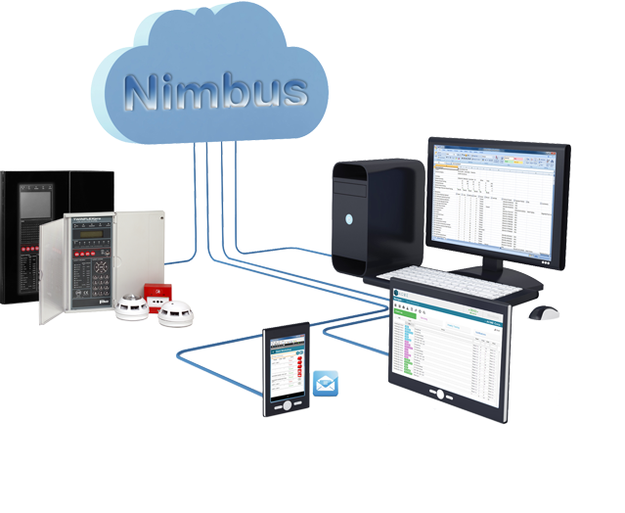
NIMBUS FIRE ALARM MANAGEMENT
Nimbus is the ideal management tool for Service, Building and Estate managers who need to maintain a life time electronic log of their fire alarm systems.

Slide 10
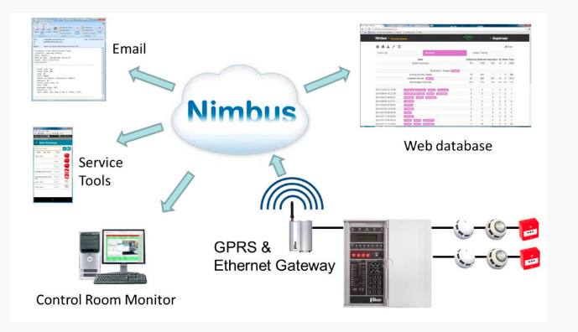
NIMBUS FIRE ALARM MANAGEMENT
The flexible web browser Nimbus interface provides you with complete visibility of all your fire alarm activity through a common presentation format. Data can be integrated with your existing desktop applications with standard Copy, CSV, Excel, PDF & Print tools.

Slide 11
REPORTS
Generate reports based on Weekly Testing, Servicing and Live activity. Users may also generate specific reports based on their own search criteria; Date/Time, Mode, Event, Panel, Loop, Device and any protocol parameter. The common web page interface simplifies the generation of reports and allows data export to; Copy, CSV, Excel, PDF or Print tools.

Slide 12
NOTIFICATIONS
Event notifications can be sent via email, mobile phone application and secure I.P. to any number of recipients based on the Fire Alarm event types; Fire, Pre Fire, Fault, Isolation, Disablement etc. Each event notification details the event action, the associated control panel descriptive labels and protocol data. Notifications are triggered and processed immediately.

Slide 13
Any number of systems
Managing any number of disparate Fire Alarm systems can be time consuming and prone to errors, especially if the systems are spread over a large area and serviced & maintained by different companies.
Nimbus centralizes all your Fire Alarm systems activity through a single cross platform management tool detailing electronic history of the Fire Alarm throughout its use and life.

Slide 14
t6 API
t6 is an Open-Source API and can be installed on your own server
Vendor – American Petroleum Institute ( API )
T6 API
Monitor your systems
Control your own data via API
Make decision (Actions triggered on events)
Objects controls Flows in your shelves - Define your own Object and Flows. Objects can store data to multiple Flows.
Snippets to customize dashboards - Snippets for re-usable and embeddable containers.
Dashboards view to graph your data - Data are displayed as graphs and included into Dashboards.

Slide 15
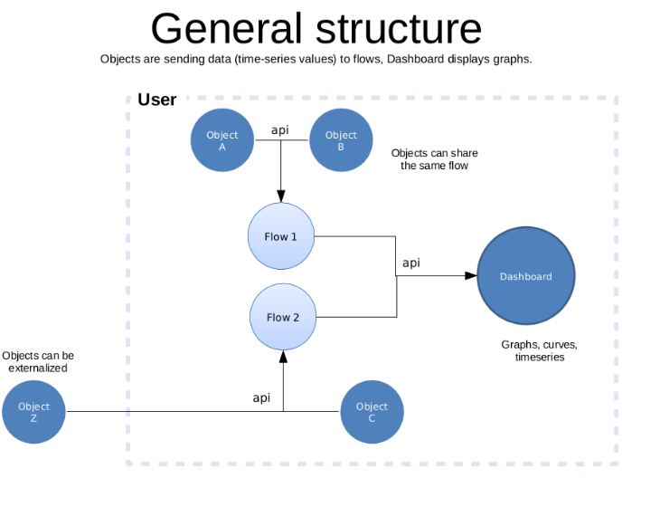
t6 API
Objects - sensors and actuators
Physical World is composed on your sensors and actuators. Physical Objects require a virtual Object in t6.
Objects in t6 are the virtual nodes of your physical devices. They are sending values from their embedded sensors to the Flows.

Slide 16
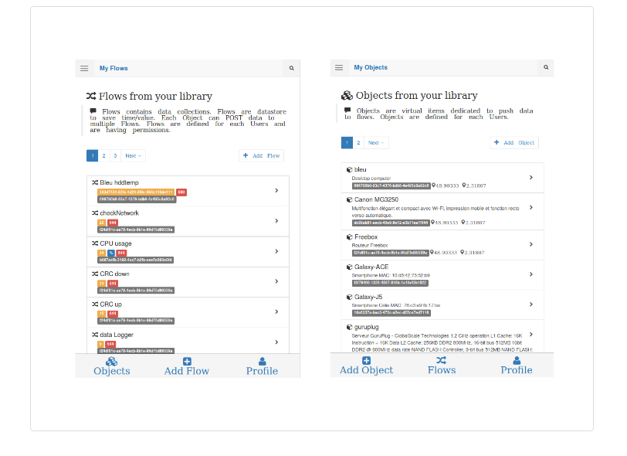
Objects controls Flows in your shelves

Slide 17
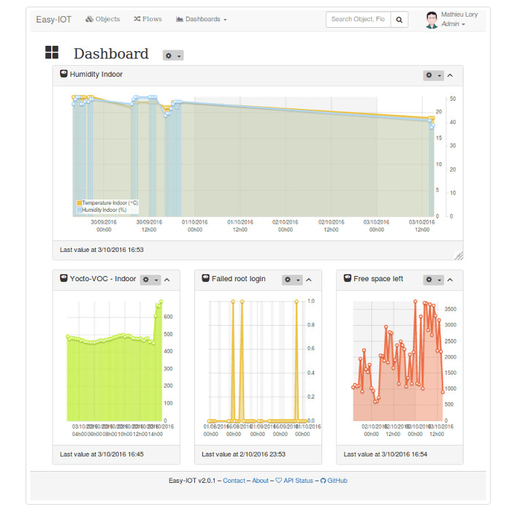
Dashboards view to graph your data

Slide 18
How does t6 works?
Objects Connected:
Embedded, Automatization, Domotic, Sensors, any Objects can be connected and communicate to t6 via API.
Data Flows as time series
Communication becomes easy in the platform with Timestamped values. Flows allows to retrieve and classify data.
Tokens for Security
Bearer Tokens allows to manage Objects & Flows API. Permissions based on access Tokens.

Slide 19
How does t6 works? (Contd..)
Snippets to graph data
t6 onboard multiple Snippets dedicated to graph your data.
Dashboards
Graphics, data-management, Monitoring, Reporting.
Decision rules to get smart
Trigger action from Mqtt and decision-tree. Let's your Objects talk to the platform as events.

Slide 20
T6 provides IOT Tools
Sense events
Whether it's your own sensors or external Flows from Internet, sensors collect values and communicate them to t6.
Store values
Data Storage as time-series. SQLite Database for storage and planning to support additional DB in future releases.
Monitor information
Real-time dashboards provides control on data captured by the sensors. You can easily monitor and track your data.

Slide 21
T6 provides IOT Tools (Contd..)
Customize your dashboards
Snippets displays your data for monitoring and reporting purposes.
Alert Notifications
According to your own rules and data values, send alerts via email, SMS, Twitter... Decision-Rule allows you to control your alerts.
API for developers
Update events Flows using the Time-series API and remotely manage your data.

Slide 22
REFERENCES
https://www.linkedin.com/pulse/nimbus-cloud-based-fire-alarm-management-oliver-newman
https://microsoft.github.io/techcasestudies/iot/2016/11/23/SkyAlert_English-Version.html
http://api.internetcollaboratif.info/
http://www.redalertsystem.com/
http://www.redalertsystem.com/demos.php
https://support.twitter.com/articles/76915
https://amtelco1call.wordpress.com/category/1call/red-alert-emergency-notification-and-social-media/
https://developers.facebook.com/docs/graph-api/reference/user/notifications

Slide 23
Thank you

Slide 24

Social Media Network’s Safety Features
Presented by
Keerthana J

Slide 25
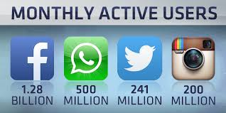
Introduction
Launched Safety Check in 2014
(Nepal Earthquake in 2011),google
Person finder in 2010.

Slide 26
Contents
Problem statement
Objective
Products With Safety Services
Facebook
Twitter
Google

Slide 27
Problem statement
Delivering information about unsafe condition.

Slide 28
Objective
To notify through some services like message.

Slide 29

Products With Safety Services
Facebook
Twitter
Google

Slide 30

Facebook
Started with natural disasters
Expanded to include non-natural incidents
Activated safety check 17 times, compared with 11 times in 2014 and 2015 combined

Slide 31
How Is Safety Check Activated
Activated In Two Ways
Notify everyone in the affected area
By a community-( post a status)

Slide 32
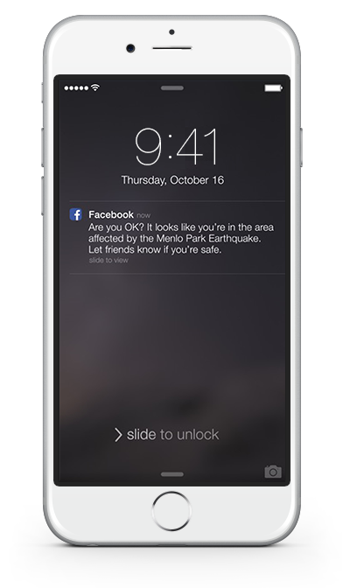
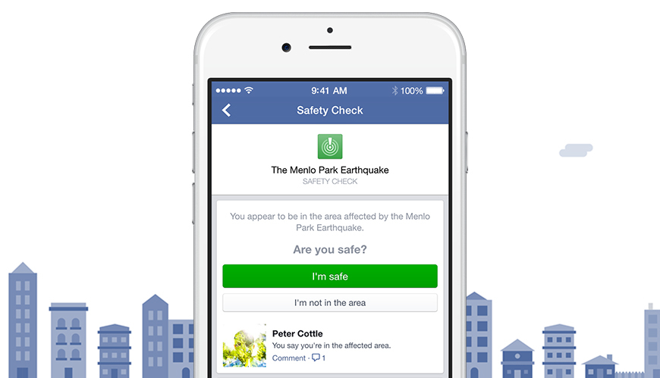

Slide 33
Factors Considering
City listed in profile
Current location given
Other signals (ex: used the internet)

Slide 34
Algorithm Behind Activation
Collect their safety status, send it.
Facebook products - “pull” model .
Safety Check is a “push” model.

Slide 35
Push Model And Its Difficulties
Find all the people - in the affected area.
Handle range of population sizes with accuracy and speed, but also remain stable.

Slide 36
Two Approachs
First approach:
A reverse index for every person who encoded current location.
Reverse index during launch to look up the people who were in a given city, region, or country.
Issue - storage and computing power to maintain.
Tradeoff between accuracy and maintaining such a large reverse index .

Slide 37
Two Approachs
Second approach
A massively distributed asynchronous job on every facebook profile.
The job would check if someone was in the area and, if so, send a notification for the crisis, then continue on to the next person.
Attractive when considering large areas of activation.
It's less efficient for small activations.

Slide 38
Overview Of The Process
Crisis is activated - run a small piece of code, or “hook,” that executes after every news feed load.
Once someone loads news feed, immediately invite that person to mark.
And his or her friends in the affected area (geographically based).
It’s a single web request (resource intensive).

Slide 39
Overview Of The Process
“Async tier,”(schedule jobs) to asynchronously iterate through all of person a's friends.
Parallel and distributed version of search across the social graph (continue iterating as long as the person is in the affected area).
Don't perform recursive searches .
In practice can exhaust a small graph of ~100,000 people in just minutes, with larger areas -10 to 15 minutes at full capacity.

Slide 40
Obeying A Digital Speed Limit
To automated systems, ( job was growing out of control).
Async tier has automatic schedule throttling built in, (upper bound would not be reached).
Triggering throttling require manual responses.
When exceeds a specified limit, additional requests are rejected

Slide 41
Propagation Delay
The initial propagation delay or the time –counters synchronized across data center regions.
Bump the counters without scheduling the job.

Slide 42
24/7 Testing And Preparedness
Proactive testing system to perform “shadow launches” (12 hours for a wide range).
Other variables, such as locations, network conditions, and usage patterns,
Logs to a database instead of sending notifications.
After a few hours, collect the number of people found, compare -historical expected bounds, and report it.

Slide 43
Crisis Bot Born On Messenger
An internal bot for messenger to both continuously monitor new launches and provide on-demand data reports.
Migrate entire launch monitoring process to mobile and co locate it

Slide 44
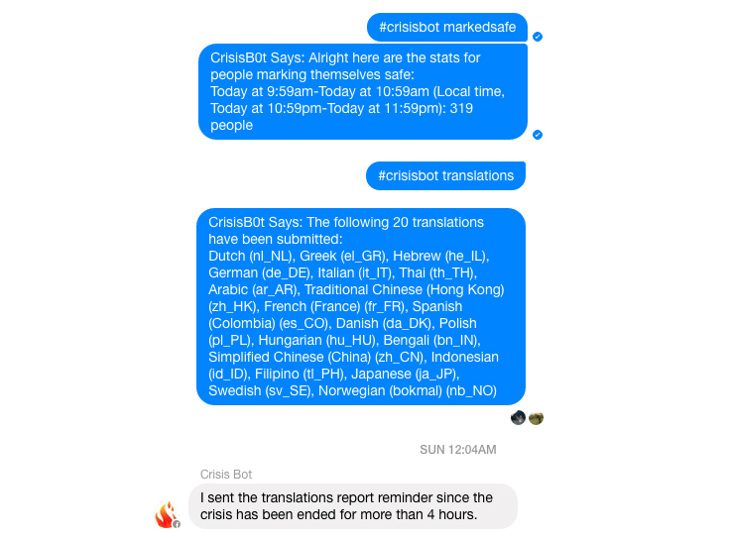

Slide 45

Twitter
Twitter's news-curation tab,- "moments," featured tweets, images and videos from news agencies and bystanders .
A slimmed-down version of own feed with tweets selected by a team of editors

Slide 46
Google - Google Person Finder
An open source web application.
Embed a small version of Google Person Finder(HTML code) directly on to the website.
Download the data(PFIF),synchronise with own database and upload it.

Slide 47
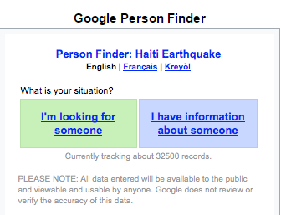

Slide 48
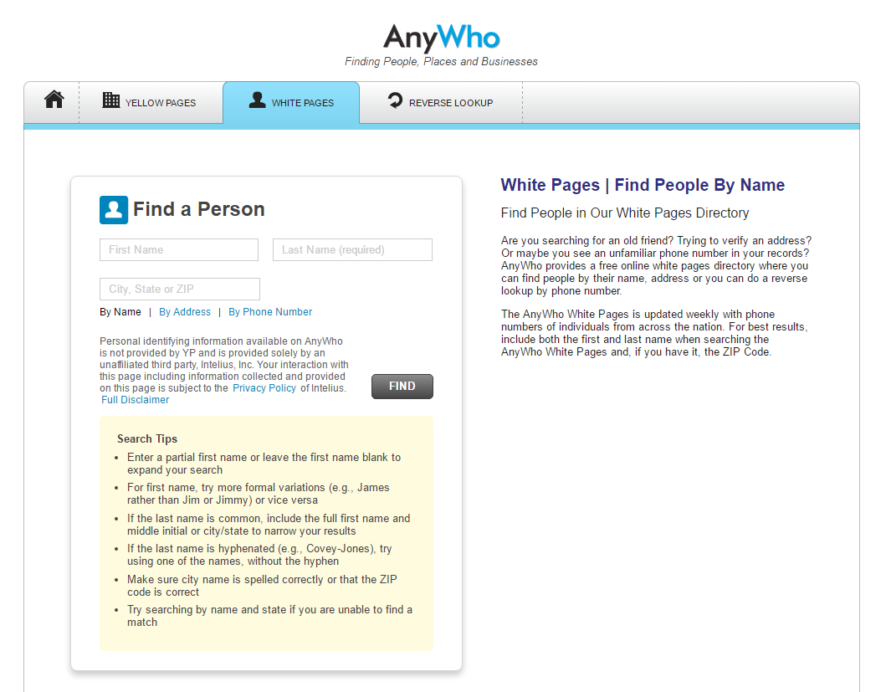
Webpages Available

Slide 49
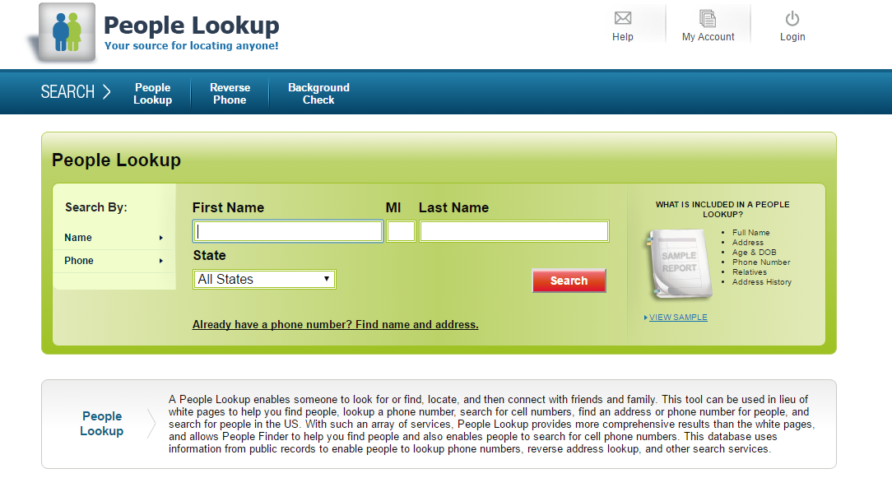
Webpages Available

Slide 50
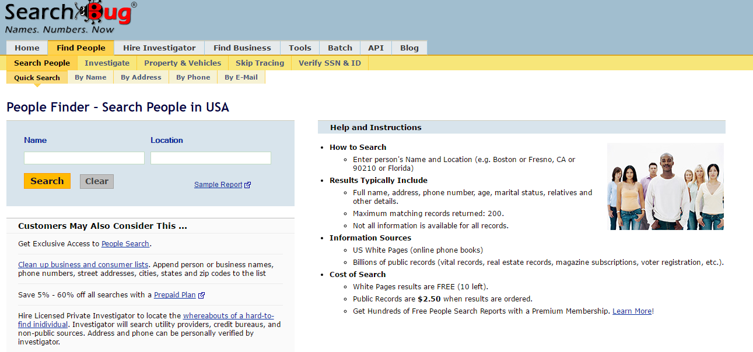
Webpages Available

Slide 51
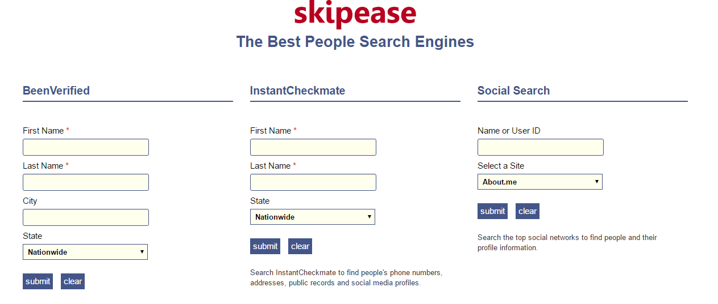
Webpages Available

Slide 52
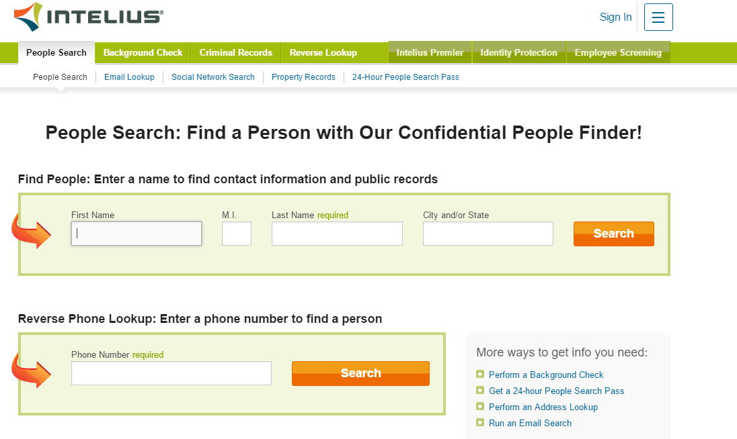
Webpages Available

Slide 53
References
www.recode.net
www.facebook.com
code.facebook.com
google.org/personfinder
en.wikipedia.org

Slide 54
Thank you

